Slide 1
HIRING
PROCESS
ANALYTICS

Slide 2
PROJECT DESCRIPTION
APPROACH
REQUIREMENTS
Hiring process is the most important and fundamental function of a company. Here the MNC’S got to know major underlying trends about the hiring process. Trends such as number of rejections, number of interviews, type of job vacancies etc. are important for a company to analyze before hiring freshers or any other individual.
We are going to understand the data first and we will check for missing or incomplete data. Afterwards we’ll identify and remove outliers from the data and then create Charts and graphs to meet the business requirements.
We will find some insights such as “HIRING”, “AVERAGE SALARY”, “CLASS INTERVAL” , “CHARTS AND PLOTS”.
TECH-STACK USED
MS EXCEL 2019

Slide 3
UNDERSTANDING THE DATA
Column Name | Description
Application_id | Unique I’d of each person, It is Represented by numbers.
Interview Taken On | Date and time description
Status | Result of Interview(Hired or Rejected)
Event_name | Classified according to Gender
Department | Department for which the interview was taken
Post Name | Define the post, including both numbers and text
Offered Salary | Salary offered as per the interview taken, represented in numbers.

Slide 4
CHECKING FOR MISSING DATA
Column Name | Missing data (if any)
Application_id | No missing data
Interview taken on | No missing data
Status | No missing data
Event_ name | There are 15 data missing in this column
Department | No missing data
Post _name | 1 missing data
Offered salary | There exists one blank row in the column

Slide 5
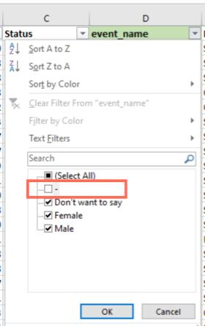
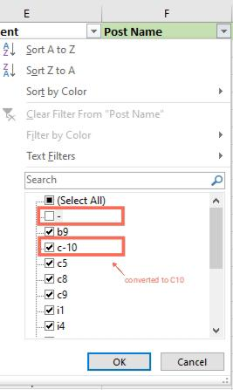
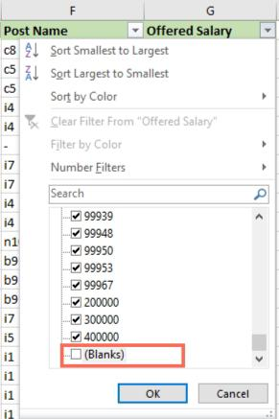
REMOVING BLANK VALUES FROM DATA
• Now, we will remove data that is blank or having outliers from our dataset. This process is very important when analyzing any data for a business because Missing values and outliers can affect our observation.
•Firstly, we will remove blank value from event name column, Offered salary column and Post Name column by applying filter.
• In Post Name column apart from blank values we will also rectify data having value(c-10) which is different from other data then, we will remove ‘-’ from the data and convert it into (C10)

Slide 6
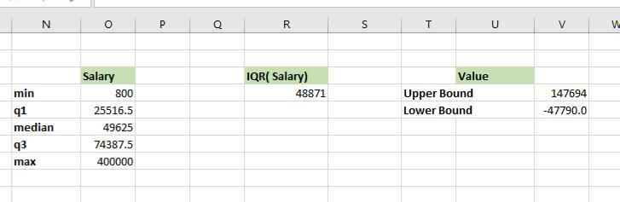
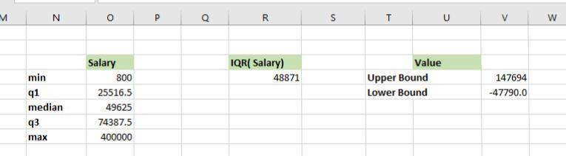
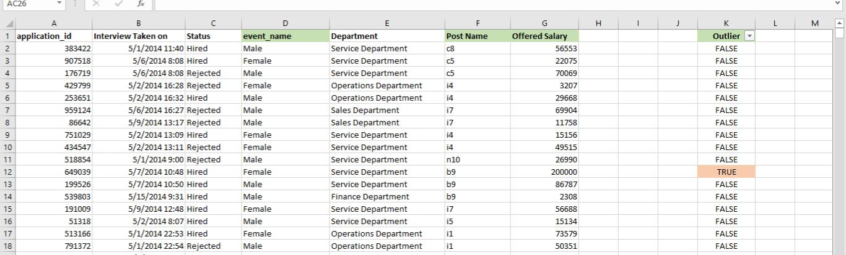
FINDING AND REMOVING OUTLIERS
• The data that falls on the far left or right side of the ordered data is tested to be the outliers. Generally, the outliers fall more than the specified distance from the first and the third quartile.
• Here, we have to use the quartile and IQR to find if there is any outlier exist in the Offered salary column dataset or not. If it exist then we’re going to remove it.
• In this dataset of offered salary above (147694) and below (-47790.0) are considered as outliers. Hence, we’ll remove it.

Slide 7
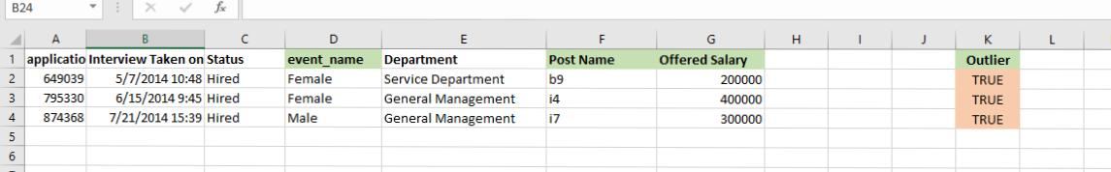
Result: We removed Total 20 data from our dataset
Total dataset-7169 After removing blank values-7152 After removing outliers-7149
• 17 data we removed from blank values that are from event name column, offered salary
column and Post Name column.
• 3 data we removed from outliers, we denoted outliers as ‘TRUE’.

Slide 8
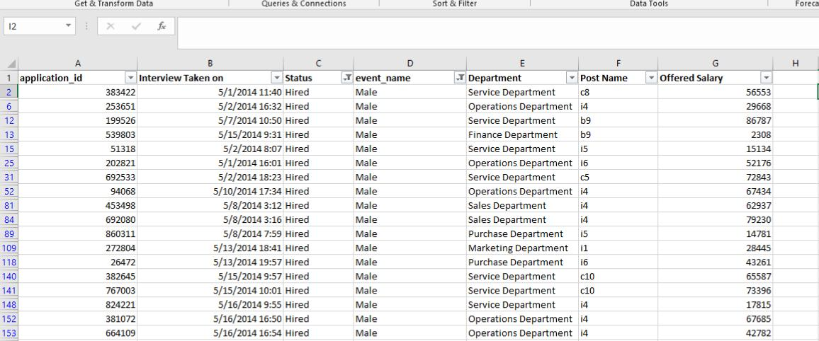
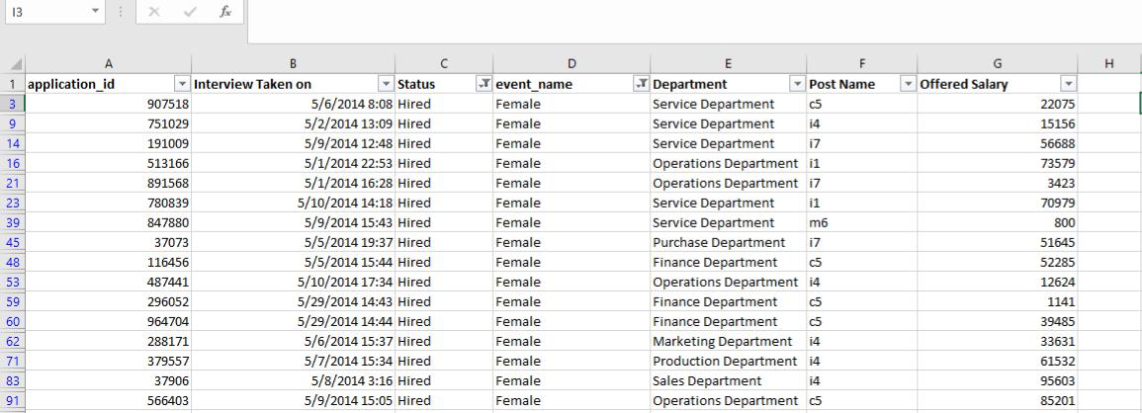
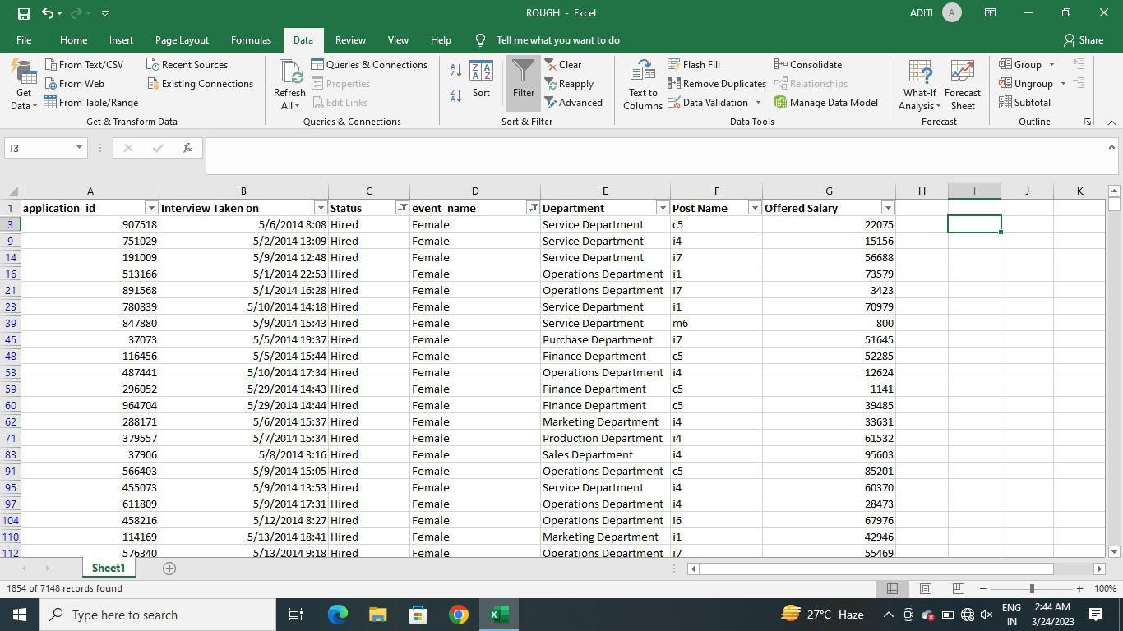
A. HIRING
Process of intaking of people into an organization for different kinds of positions. Your task: How many males and females are Hired?

Slide 9
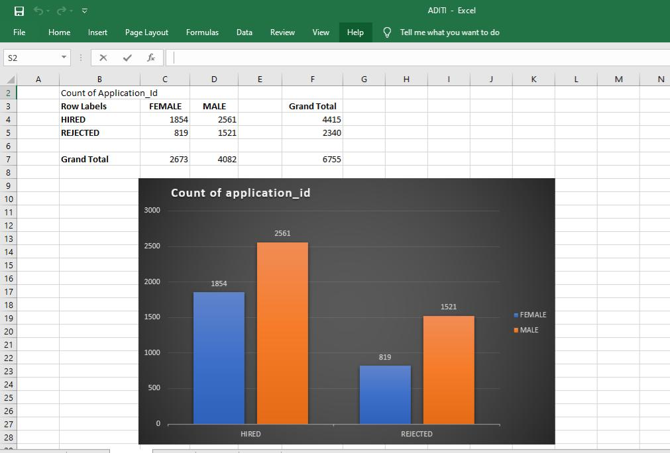
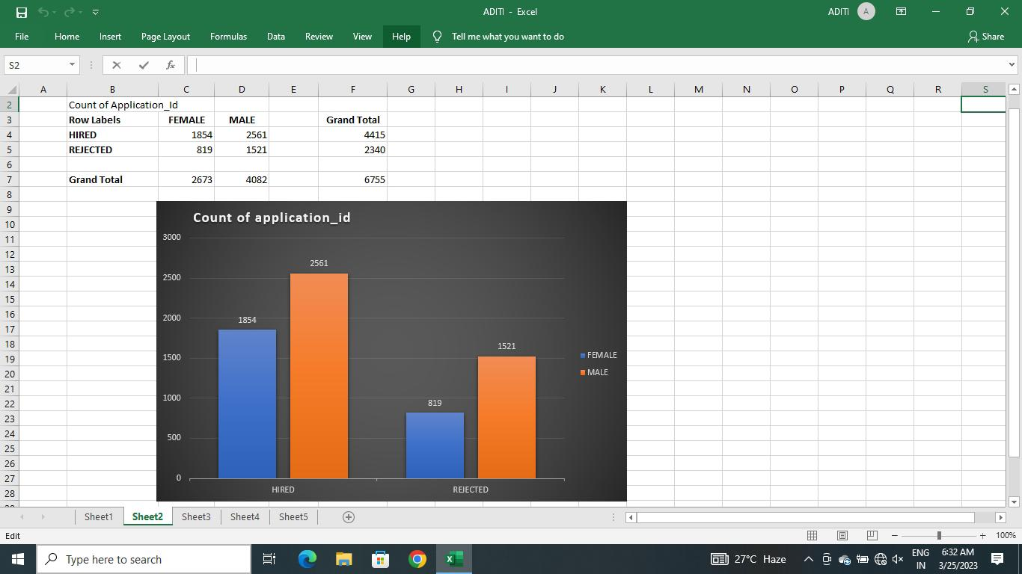
Result: Number of males hired is 2561 and number of females hired is 1854, it clearly shows
that males are hired more as compared to females in the company.

Slide 10
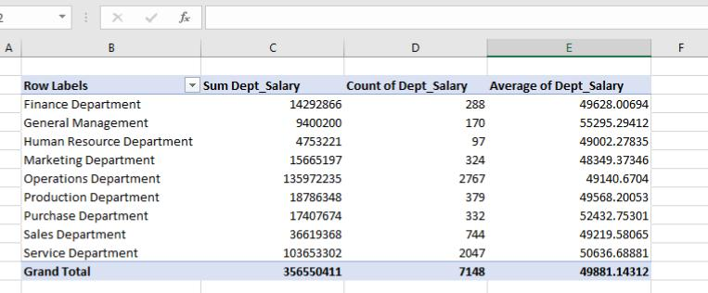
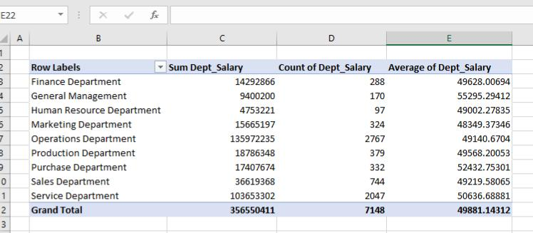
B. AVERAGE SALARY
Adding all the salaries for a select group of employees and then dividing the sum by the number of employees in the group. Your task: What is the average salary offered in this company?

Slide 11
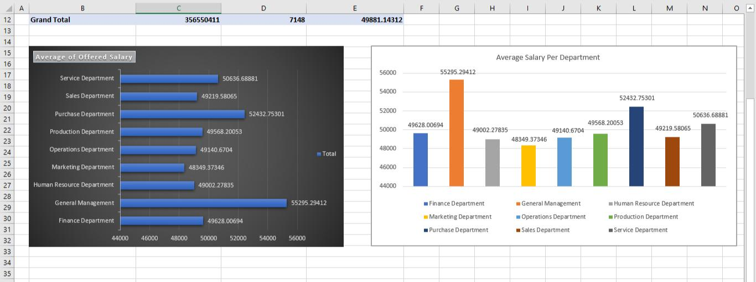
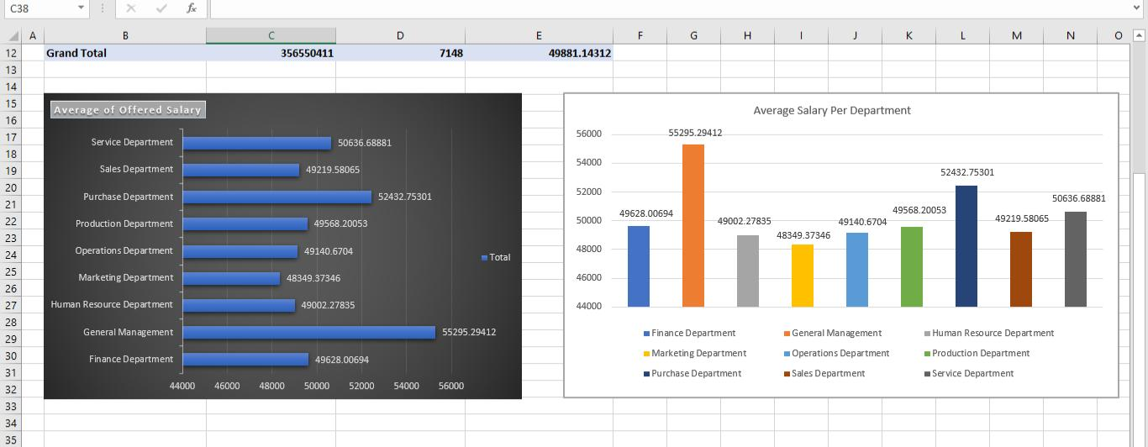
Result: Maximum average salary is offered by General Management Department (55295.29) and least offered average salary is by Marketing Department (48349. 37)

Slide 12
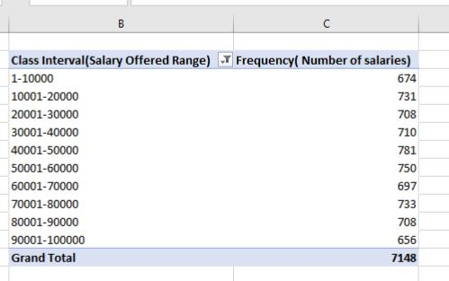
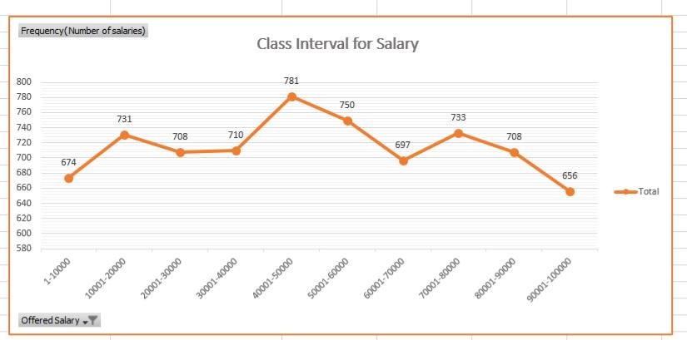
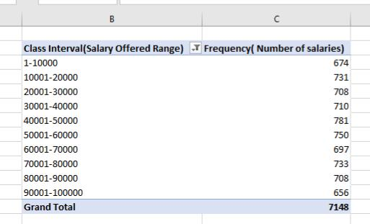
C. CLASS INTERVALS
The class interval is the difference between the upper class limit and the lower class limit. Your task: Draw the class intervals for salary in the company?
Result: Maximum frequency of salary comes under the class interval 40001-50000.
We created a class interval of 10000 to get the better understanding

Slide 13
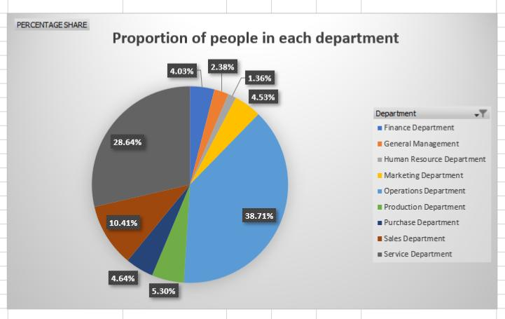
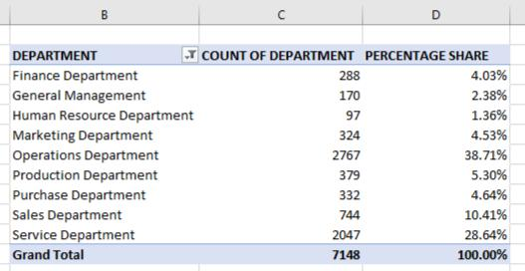
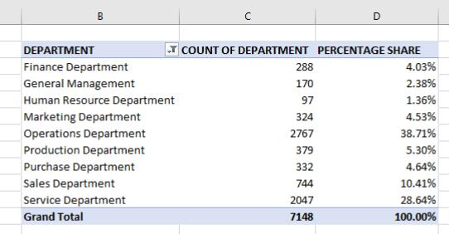
D. CHARTS AND PLOTS
This is one of the most important part of analysis to visualize the data.
Your task: Draw Pie Chart / Bar Graph (or any other graph) to show proportion of people working different department?
Result: Percentage share of operation department is maximum (38.71%) and least share is
occupied by HR department (1.36%)

Slide 14
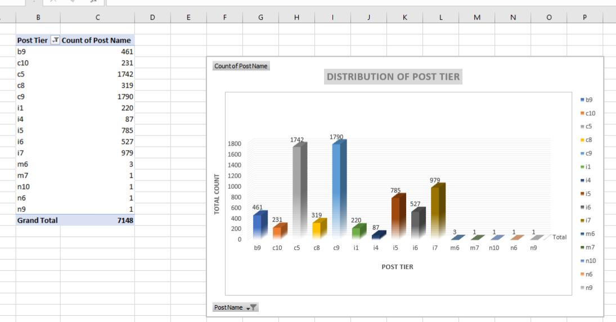
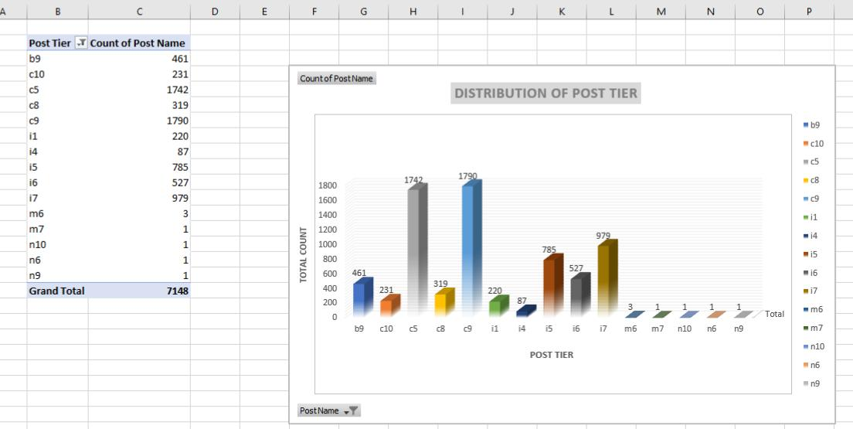
E. CHARTS
Use different charts and graphs to perform the task representing the data. Your task: Represent different post tiers using chart/graph?
Result: C5 and C9 have the maximum count and M7 to n9 have only 1 candidates each.

Slide 15
TAKEAWAY
How to get insights about the requirement to run a business in excel.
How to create class interval.
How to use Quartile and IQR to find Outliers.
How to find and remove outliers to get better insight.
Excel Visualization.

Slide 16


